Slide 1

3D Vision LLM
3D OBJECT CAPTIONING - WEEK #5
8-22-2024
Submitted by:
Mr. FAZZA Abdellah - ENSAM Casablanca (Big Data & IoT)
3D SMART FACTORY

Slide 2

Plan
Overview
Selected Model
Vision-Language Models
Conclusion and Future Work
Finalists
1

Slide 3



Overview
The proposed 3D object captioning pipeline includes an image captioning step. In this presentation, I will showcase several Vision-Language Models (VLMs) that I discovered during my research, with a focus on those that are less resource-intensive. As the presentation progresses, I narrow down the list to VLMs that meet specific criteria. Finally, I will highlight the model that achieved the best balance between size and performance.
Image Captioning
Caption Selection
Captions Fusing
Rendering
2

Slide 4
Vision-Language Models
Vision-Language Models (VLMs) are designed to understand and generate content that includes both images and text, enabling them to tackle tasks like image captioning, visual question answering (VQA), and text-to-image generation.
3

Slide 5
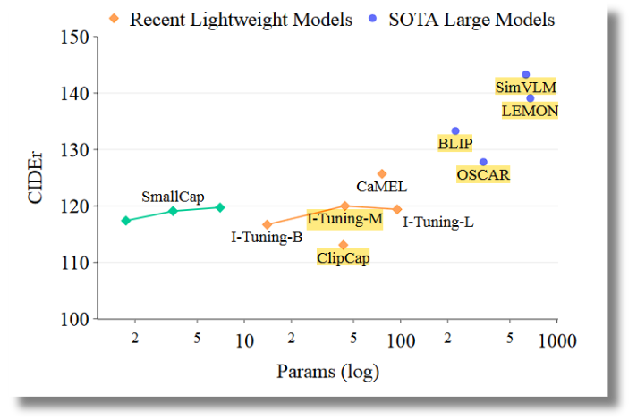

Vision-Language Models (Retrieval Augmentation Based)
SMALLCAP: Lightweight Image Captioning Prompted with Retrieval Augmentation
Camparison conducted by: SmallCAP
4

Slide 6
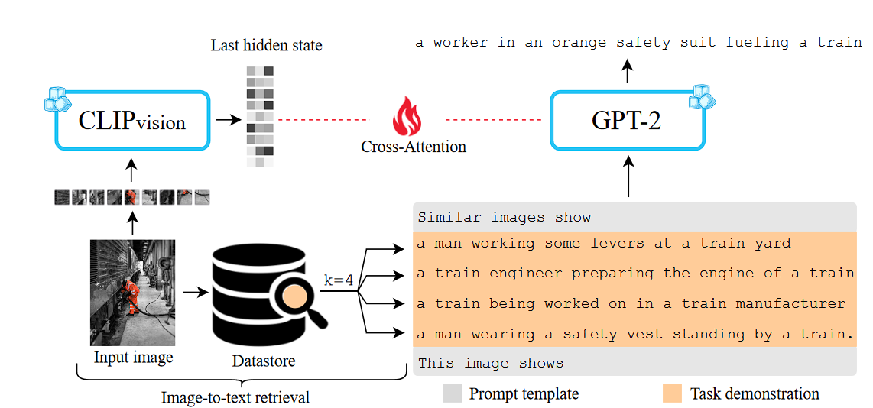
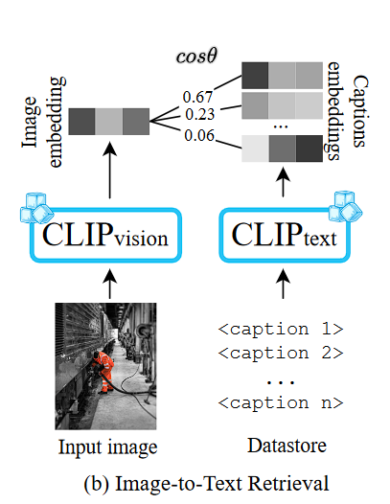
Vision-Language Models (Retrieval Augmentation Based)
Image Captioning with Retrieval Augmentation (Architecture)
SmallCAP Architecture
5

Slide 7
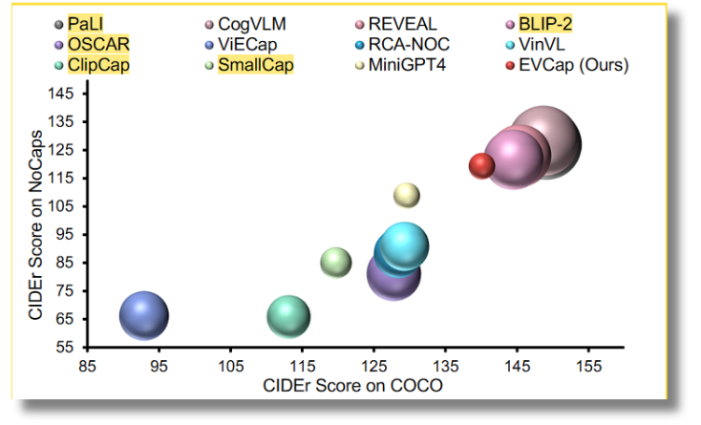
Vision-Language Models (Retrieval Augmentation Based)
EVCAP: Retrieval-Augmented Image Captioning with External Visual–Name Memory for Open-World Comprehension
Camparison conducted by: EVCAP
6

Slide 8
Vision-Language Models (STOFA Models)
BLIP: Bootstrapping Language-Image Pre-training for Unified Vision-Language Understanding and Generation
GIT: A Generative Image-to-text Transformer for Vision and Language
Oscar: Object-Semantics Aligned Pre-training for Vision-Language Tasks
SimVLM: Simple Visual Language Model Pretraining with Weak Supervision
7

Slide 9
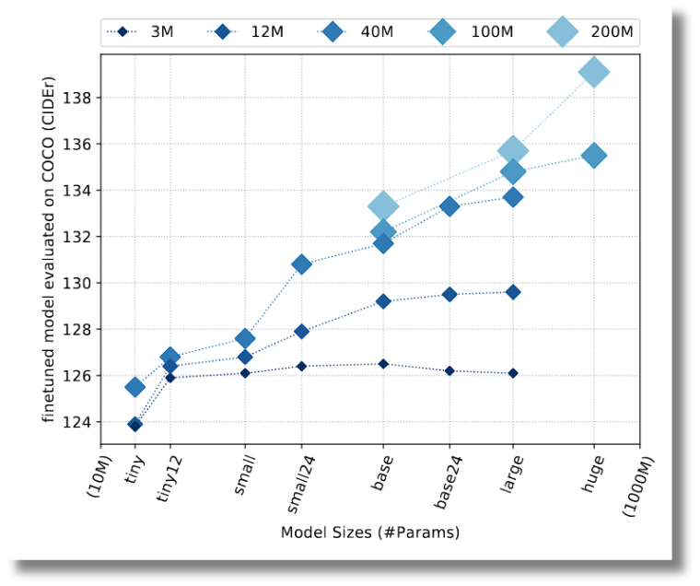
Vision-Language Models (STOFA Models)
Scaling Up Vision-Language Pre-training for Image Captioning (LEMON)
Increasing the model size is not significantly beneficial at small pre-training dataset scales.
When using sufficiently large datasets, we see strong performance boost from a larger model.
Camparison conducted by: LEMON
8

Slide 10
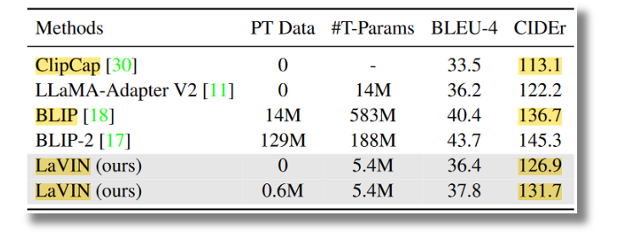
Vision-Language Models (STOFA Models)
Cheap and Quick: Efficient Vision-Language Instruction Tuning for Large Language Models (LaVIN)
Camparison conducted by: LaVIN
9

Slide 11
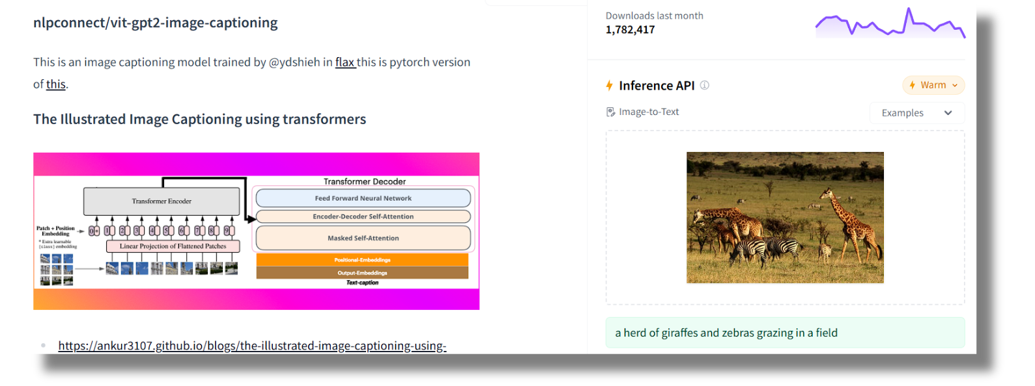
Vision-Language Models (STOFA Models)
nlpconnect/vit-gpt2-image-captioning
ViT-GPT2 on HuggingFace
10

Slide 12
Vision-Language Models (Lightweight Models)
Compressing Visual-linguistic Model via Knowledge Distillation
Transfer knowledge from a large, complex model (called the teacher model) to a smaller, simpler model (called the student model).
Encourage the student model to mimic the behavior of the teacher model.
E2E-VLP: End-to-End Vision-Language Pre-training Enhanced by Visual Learning
Uses a Transformer Encoder and Transformer Decoder to reduce the computational resources expenses.
Doesn’t use CLIP or any ViT as an image encoder, nor a LLM as a decoder, unlike most of the models.
The encoder and the decoder are trained End-to-End.
11

Slide 13
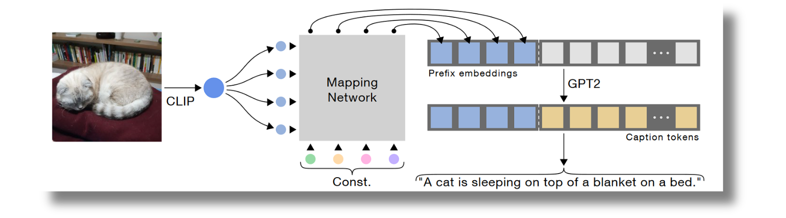
Vision-Language Models (Lightweight Models)
ClipCap: CLIP Prefix for Image Captioning
ClipCap Archetecture
The goal, like most of the models out there, is to leverage existing models (e.g. CLIP, GPT), while only training a minimal mapping network.
12

Slide 14
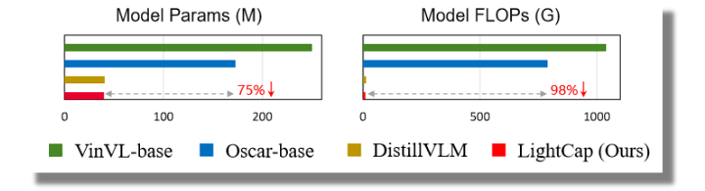
Vision-Language Models (Lightweight Models)
Efficient Image Captioning for Edge Devices (LightCap)
Comparison conducted by: LightCap
LightCap exhibits a fast inference speed of 188ms per image. which is perfect for practical applications.
13

Slide 15
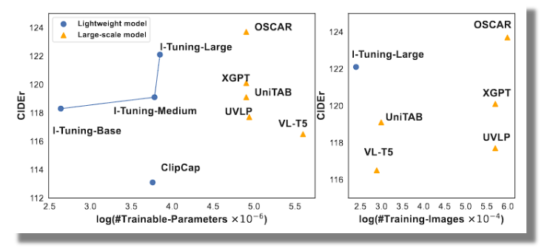
Vision-Language Models (Lightweight Models)
I-TUNING: Tuning Frozen Language Models with Image for Lightweight Image Captioning
Comparison conducted by: I-Tuning
14

Slide 16
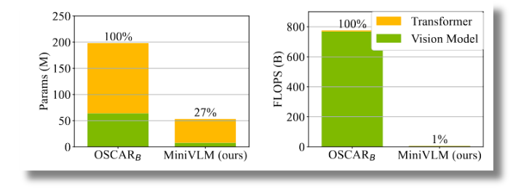
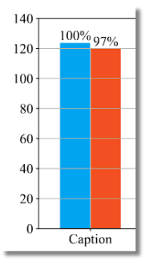
Vision-Language Models (Lightweight Models)
MiniVLM: A Smaller and Faster Vision-Language Model
Comparisons conducted by: MiniVLM
MiniVLM retains 97% of the accuracy on image captioning with 27% parameters and 1% FLOPS compared to state-of-the-art model OSCAR (Base)
15

Slide 17
Vision-Language Models (Lightweight Models)
PaliGemma: A versatile 3B VLM for transfer
Open model, continuing the line of PaLI vision-language models in a combination with the Gemma family of language models.
Similar model: Pali-3 Vision Language Models: Smaller, Faster, Stronger
16

Slide 18





Finalists
Publicly Available?
Efficient Resource Usage?
Why Zero-Shot?
Relying on a model that performs well in zero-shot tasks can save me time and resources, as it reduces the need for task-specific fine-tuning.
Rendering 2D images of various 3D object from multiple viewpoints might result in weird-looking images.
Performance on Zero-Shot Metrics?
17

Slide 19
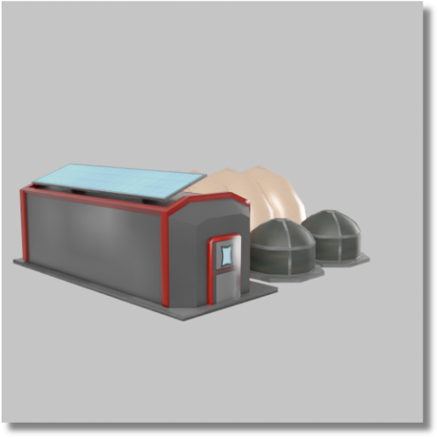
Finalists
GIT-base: 3D model of a cooler
BLIP-base: a 3D printer machine with a printer head
Vit+GPT2: a microwave oven sitting on a table
PaliGemma: in this image we can see a building
18

Slide 20
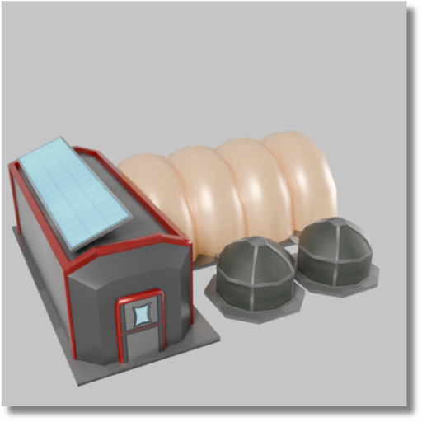
Finalists
GIT-base: 3d model of a house
BLIP-base: a solar powered device with a solar panel
Vit+GPT2: a table topped with a variety of different colored vases
PaliGemma: in this image we can see a 3d model of a building
19

Slide 21
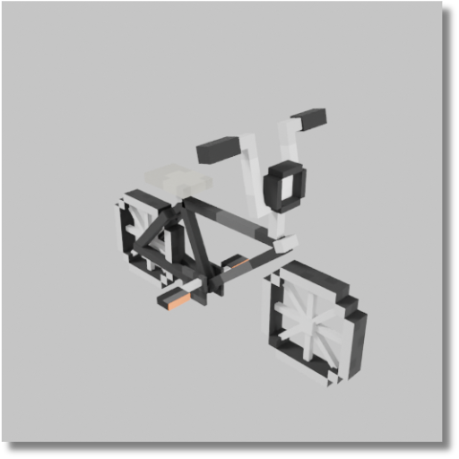
Finalists
GIT-base: 3d printed illustration of a microscope
BLIP-base: a black and white dog with a white face
Vit+GPT2: a skateboard with a propeller attached to it
PaliGemma: in this image we can see a 3d model of a bicycle
20

Slide 22
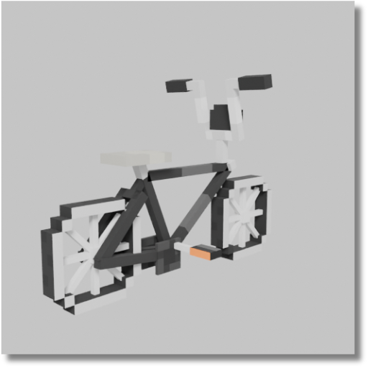
Finalists
GIT-base: digital art selected for the #
BLIP-base: a black and white bike with a white and orange design
Vit+GPT2: a small robot is attached to a piece of metal
PaliGemma: in this image we can see a 3d model of a bicycle
21

Slide 23
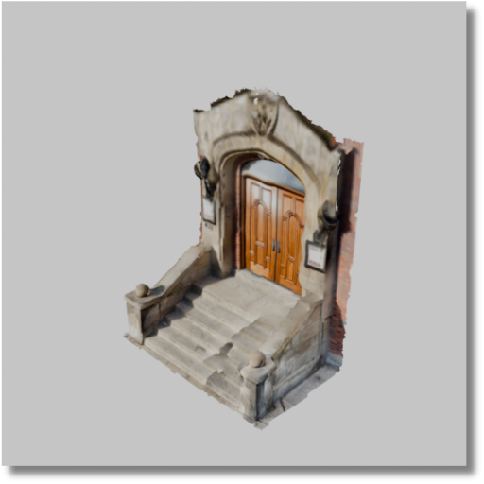
Finalists
GIT-base: the stairs of the house
BLIP-base: a door is open on a grey background
Vit+GPT2: a small wooden structure with a ladder on top
PaliGemma: in this image we can see a 3d model of a bulding
22

Slide 24
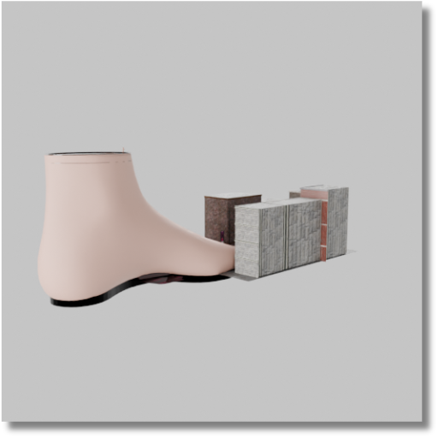
Finalists
GIT-base: the boot is designed to be used a wall mounted boot
BLIP-base: a pair of pink boots and a box of books
Vit+GPT2: a person’s feet are on a book
PaliGemma: in this image we can see a shoe and some objects
23

Slide 25
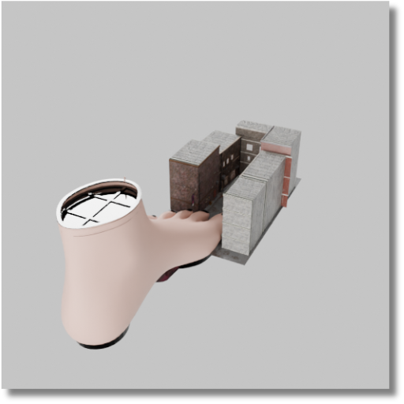
Finalists
GIT-base: a 3d model of a cup of coffee
BLIP-base: a pink cup with a brick in it
Vit+GPT2: a clock is shown on a table
PaliGemma: in this image we can see a 3d model of a building
24

Slide 26
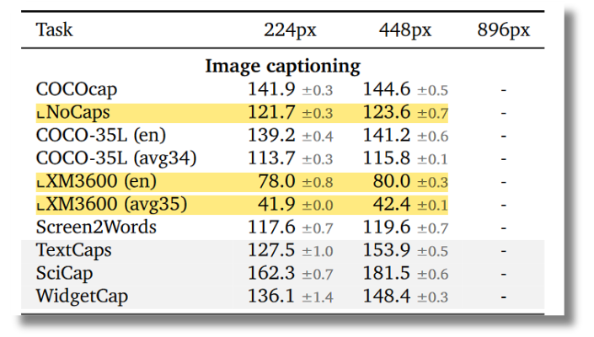

Selected Model
PaliGemma: A versatile 3B VLM for transfer
Results obtained with PaliGemma
This score suggests good performance on the English subset of the XM3600 benchmark.
The model may struggle more with the average performance across 35 languages in the XM3600 benchmark
25

Slide 27
Selected Model
PaliGemma: A versatile 3B VLM for transfer
PaliGemma: A 3d model of a stone and wood door with stairs. The door is brown with a wooden frame and has a stone archway above it. The stairs are made of concrete and lead up to the door. There are two lights on the wall next to the door, and two lights on the wall above the stairs. The door has a handle on the left side and a handle on the right side. The archway has a design on the top, and the stone wall has a design on the top. The door is flanked by two wooden doors on either side, and there is a stone railing next to the stairs.
PaliGemma with custom prompt: “caption this image of a 3D model”
26

Slide 28
Selected Model
PaliGemma: A versatile 3B VLM for transfer
PaliGemma: A black and white pixelated bicycle
PaliGemma with custom prompt: “caption this image of a 3D model”
27

Slide 29
Conclusion and Future Work
The quality of the 3D object captions is closely tied to the quality of the image captions. One approach to enhancing the image captions is by fine-tuning the image captioning model on a labeled dataset of images depicting 3D objects (e.g. few-shot fine-tuning). However, such a dataset may not exist. Therefore, I propose generating multiple images (e.g., four) of each 3D object, using the object’s label as the label for all associated images.
Additionally, to reduce resource usage, we can compress the images before passing them to the image captioning model.
28

Slide 30

Thank You
for your attention

